Slide 1
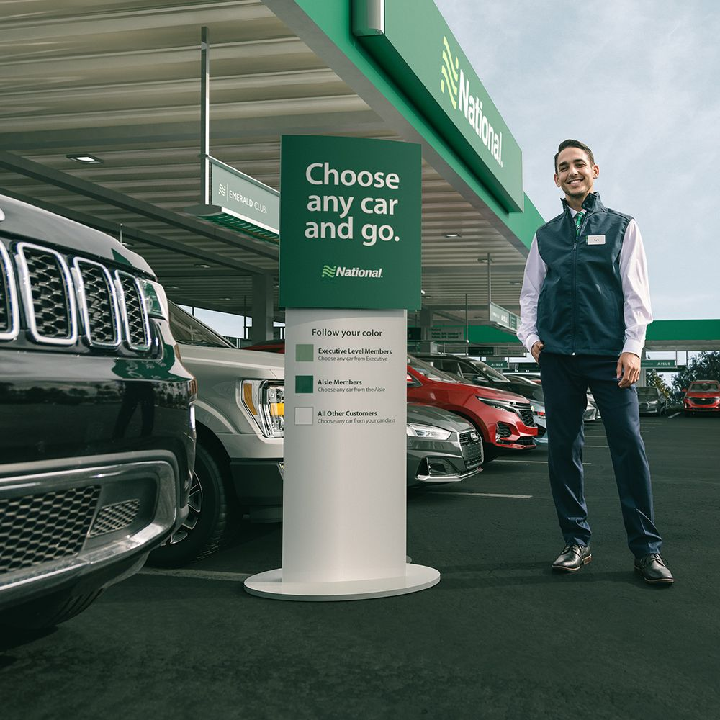
Car Rental Application
Team 16
12.04.2024

Slide 2
Requirements
Data Requirements
12.04.2024

Slide 3
Requirements
Owners
For each owner, we record their name, email (which serves as the unique identifier for each owner), phone number, password and identification details. Owners are uniquely identified by their email address.
Clients
For each client (renter), we record their name, age, email (which serves as the unique identifier for each client), password, phone number, Driving License number and identification details. Clients are identified by their unique email address.
Cars
For each car, we record its make, model, year, license plate, VIN (Vehicle Identification Number, which is unique for each car), daily price, and the owner’s email (a foreign key reference to the owner’s record). Each car is identified by its unique VIN.
Rentals
For each rental, we record the start date, return date, VIN (a foreign key reference to the car), and the renter (using the client’s email address as a foreign key reference to the client record). Each rental is identified by a composite key consisting of the start date, client email, and VIN may be used.
12.04.2024

Slide 4
Requirements
Application Requirements
12.04.2024

Slide 5
Requirements
Managing Cars
Owners should be able to post a new car for rent, specifying car information (such as pricing, and car details).
Availability
If a car is currently rented, it should not be available for new rentals during that period.
Searching for Cars
The main functionality is a search interface for cars. Clients should be able to browse through available cars by scrolling the application page, viewing cars currently available for rent.
Renting a Car
The search interface should allow clients to rent a car that is available for the desired dates. The rental fee should be based on the car’s daily price and the duration of the rental period.
12.04.2024

Slide 6
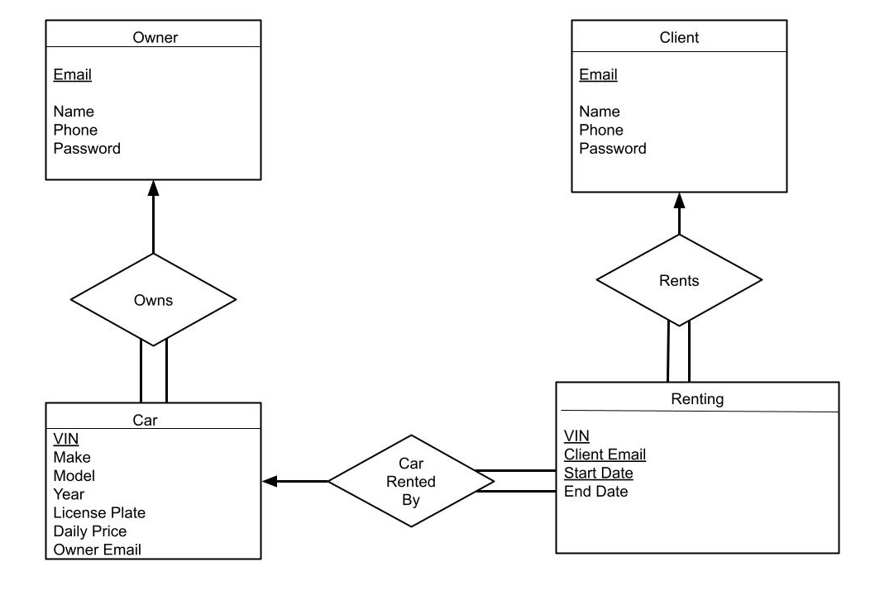
ER
Diagram
12.04.2024

Slide 7
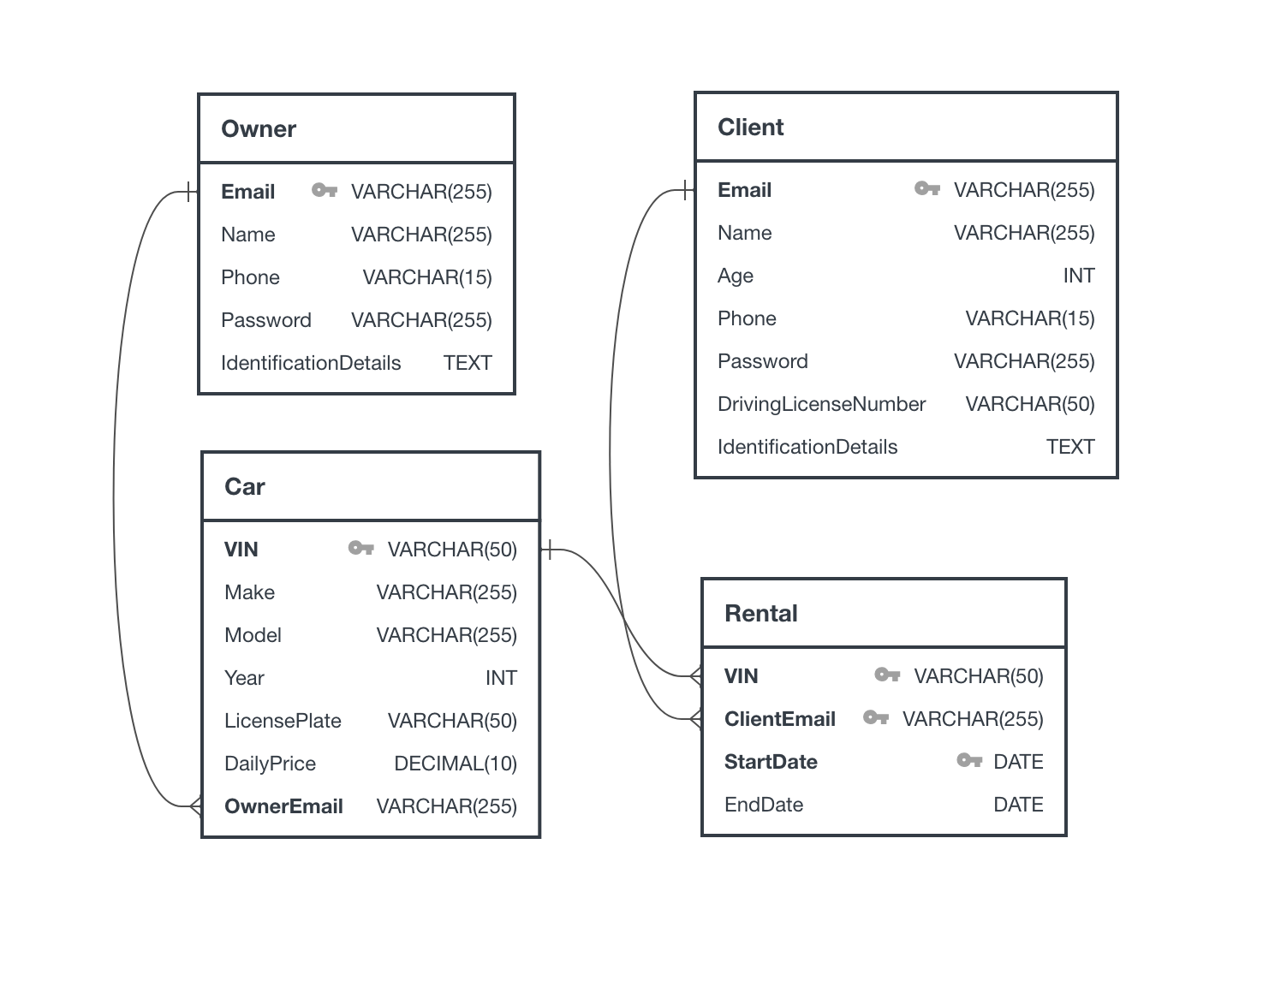
Relational
Schema
12.04.2024

Slide 8
Development
Front End
12.04.2024

Slide 9

Development
We designed and structured the web application's pages using HTML, ensuring a clear and user-friendly layout. This foundational work provides the framework for integrating other technologies like CSS and JavaScript to enhance functionality and design.
We have a home page and then we divided the pages into two distinct interfaces: one for the client and another for the owner. This separation ensures that each user group has access to the specific features and information relevant to their needs.
12.04.2024

Slide 10
Development
We divided the pages into two distinct interfaces: one for the client and another for the owner. This separation ensures that each user group has access to the specific features and information relevant to their needs.
Home Page
Owner Pages
Client Pages
Add Page
Owner Homepage
Available Cars
View Rentals
12.04.2024

Slide 11
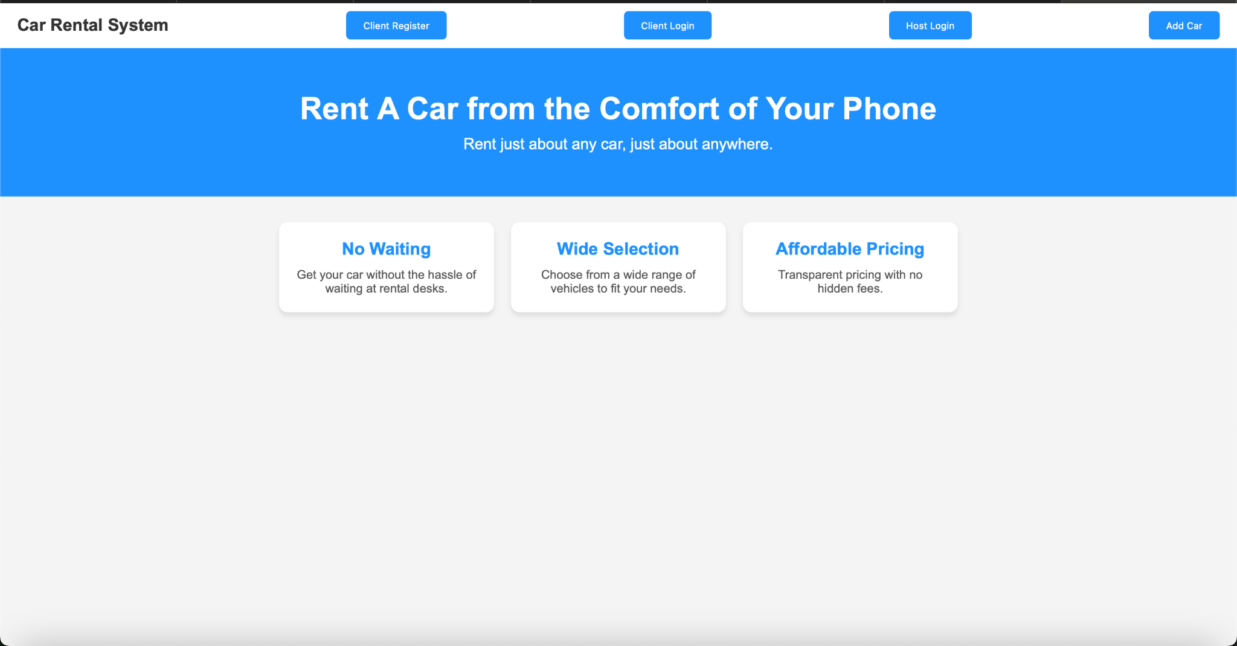
Development
Home
Page
First page of the application
12.04.2024

Slide 12
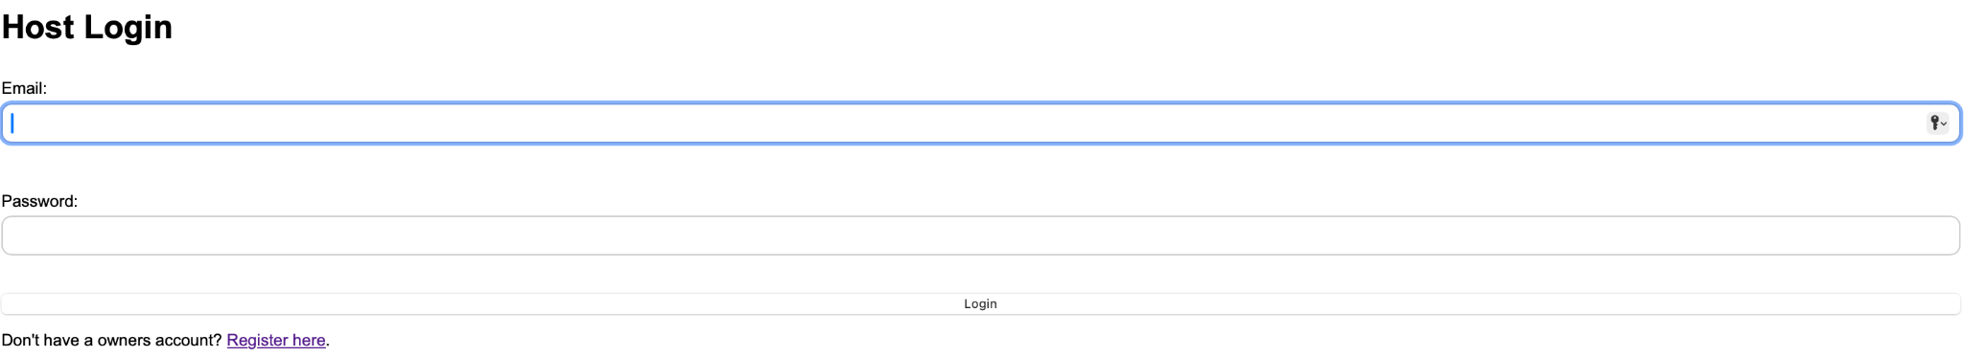
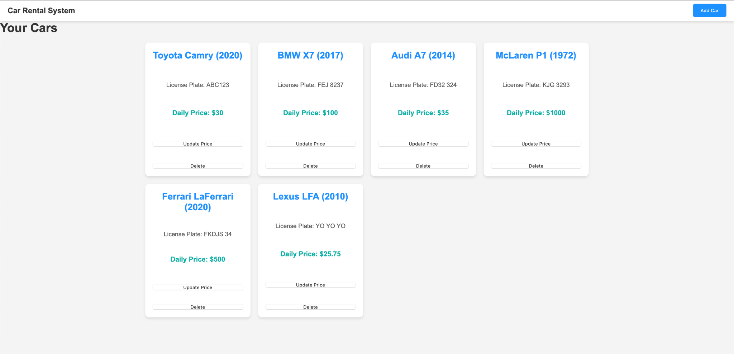

Development
Owner Login
Owner
Pages
Owners Cars
Add Car Page
12.04.2024

Slide 13
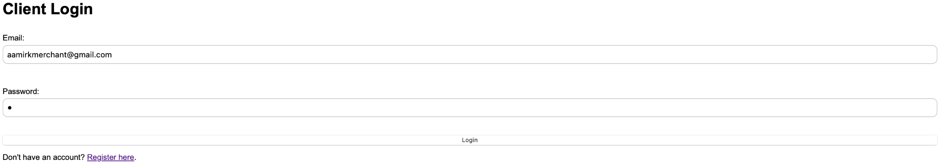
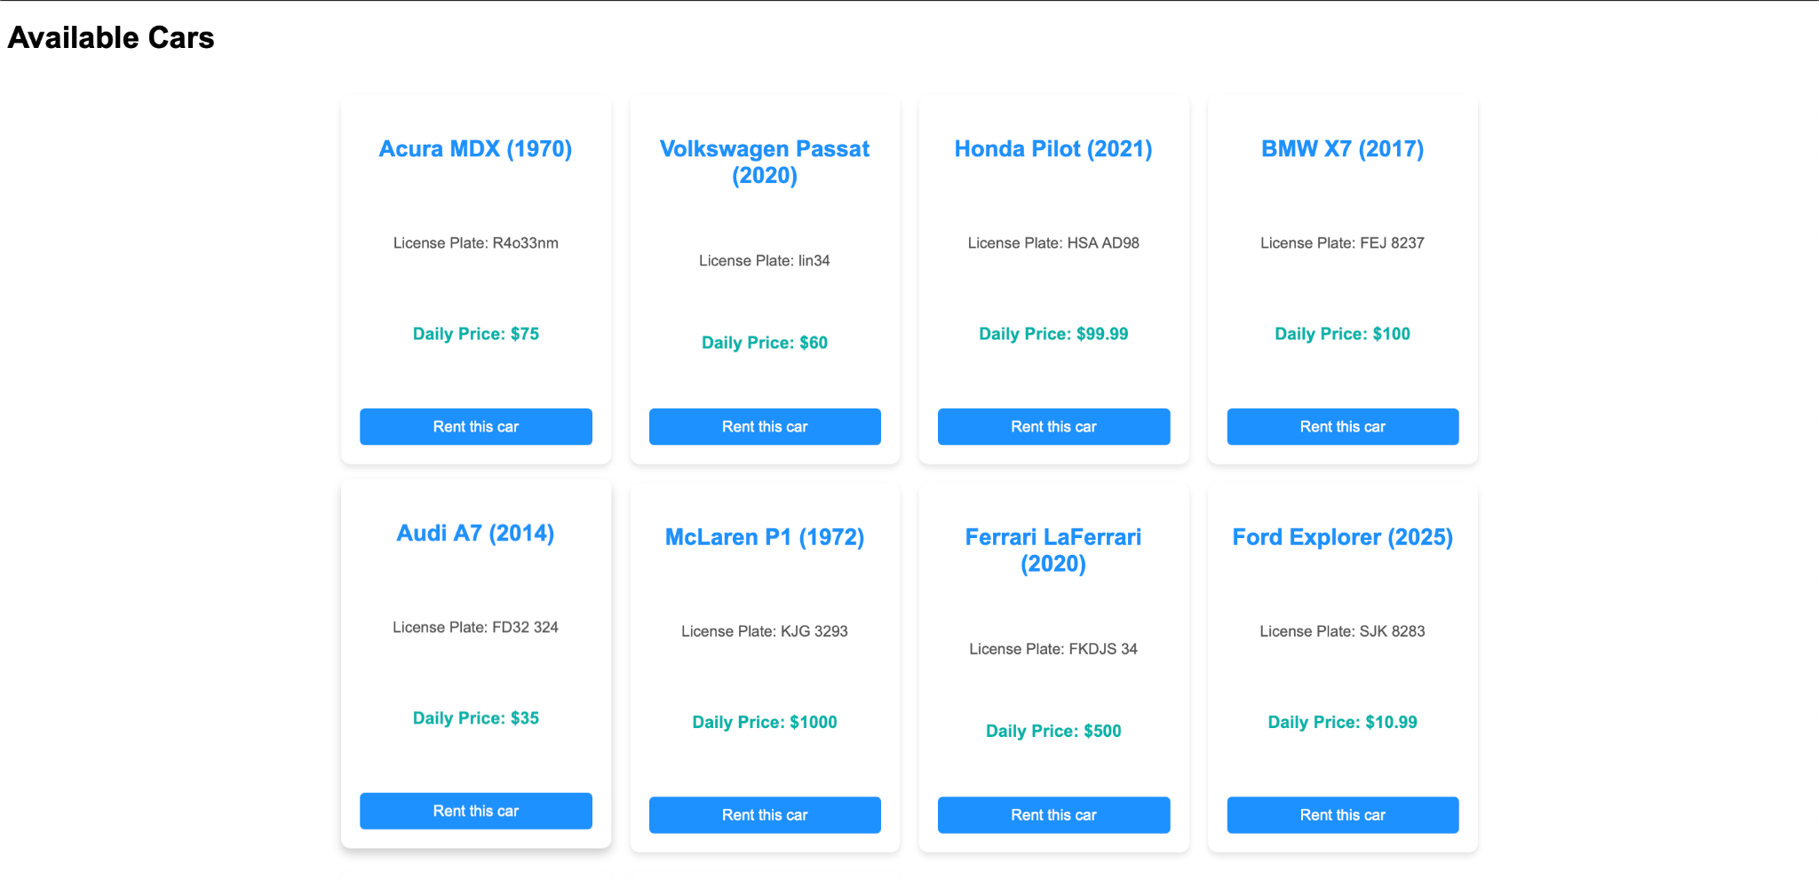
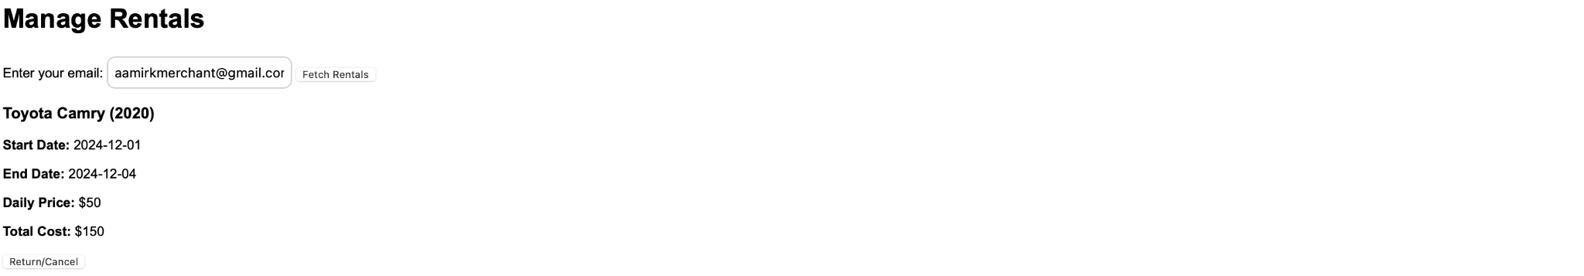
Development
Client Login
Client
Pages
Client Searching
Client Management Rentals
12.04.2024

Slide 14
Development
Back End
MM.DD.YYYY

Slide 15


Development
We used Node JS and Express to build the back end, ensuring efficient handling of server-side operations including database interactions, route handling, and API. For database creation, we opted for sqlite3, providing a lightweight and reliable solution for data storage and management.
12.04.2024
Notes:
Express was the back end, sqlite3 for database creation, CSS HTML and JS was used for the fontend. You can use node js and express js logos for any photos if u want.

Slide 16
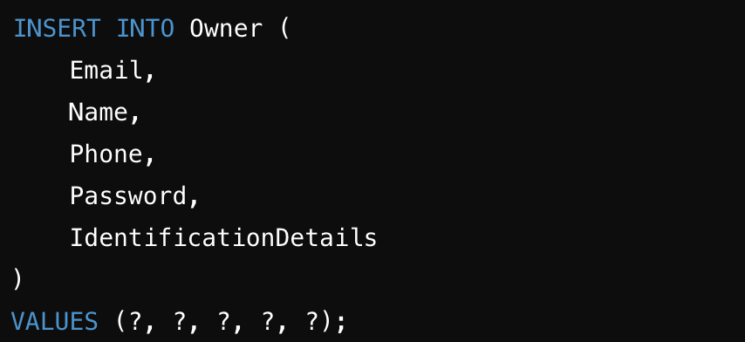
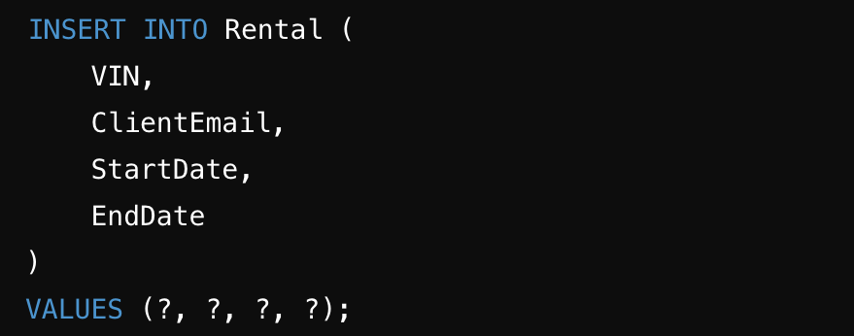
Development
Insertion Queries
Owner registration
Car rental
12.04.2024

Slide 17
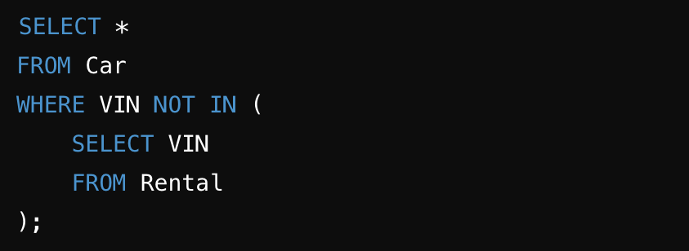
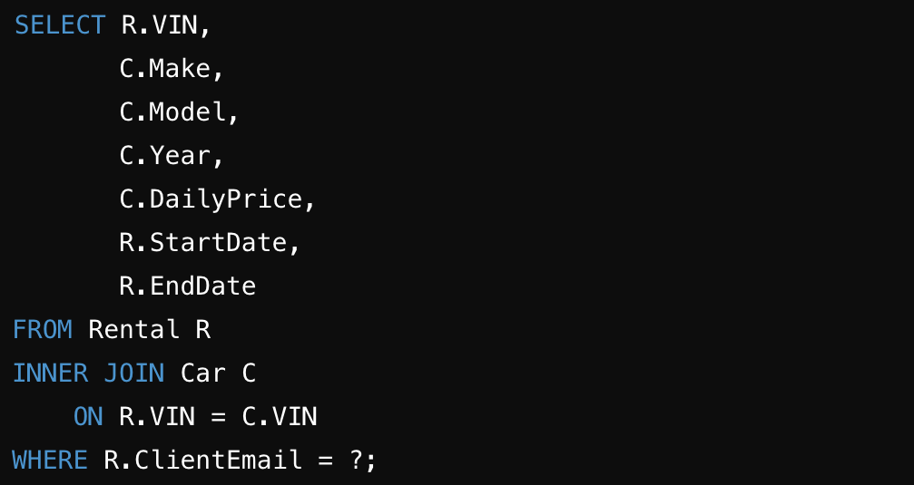
Development
Selection Queries
Available Cars
Client rentals
12.04.2024

Slide 18
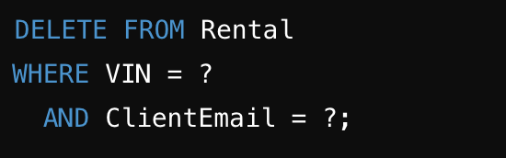
Development
Deletion Queries
Return/Cancel a Rental
12.04.2024

Slide 19
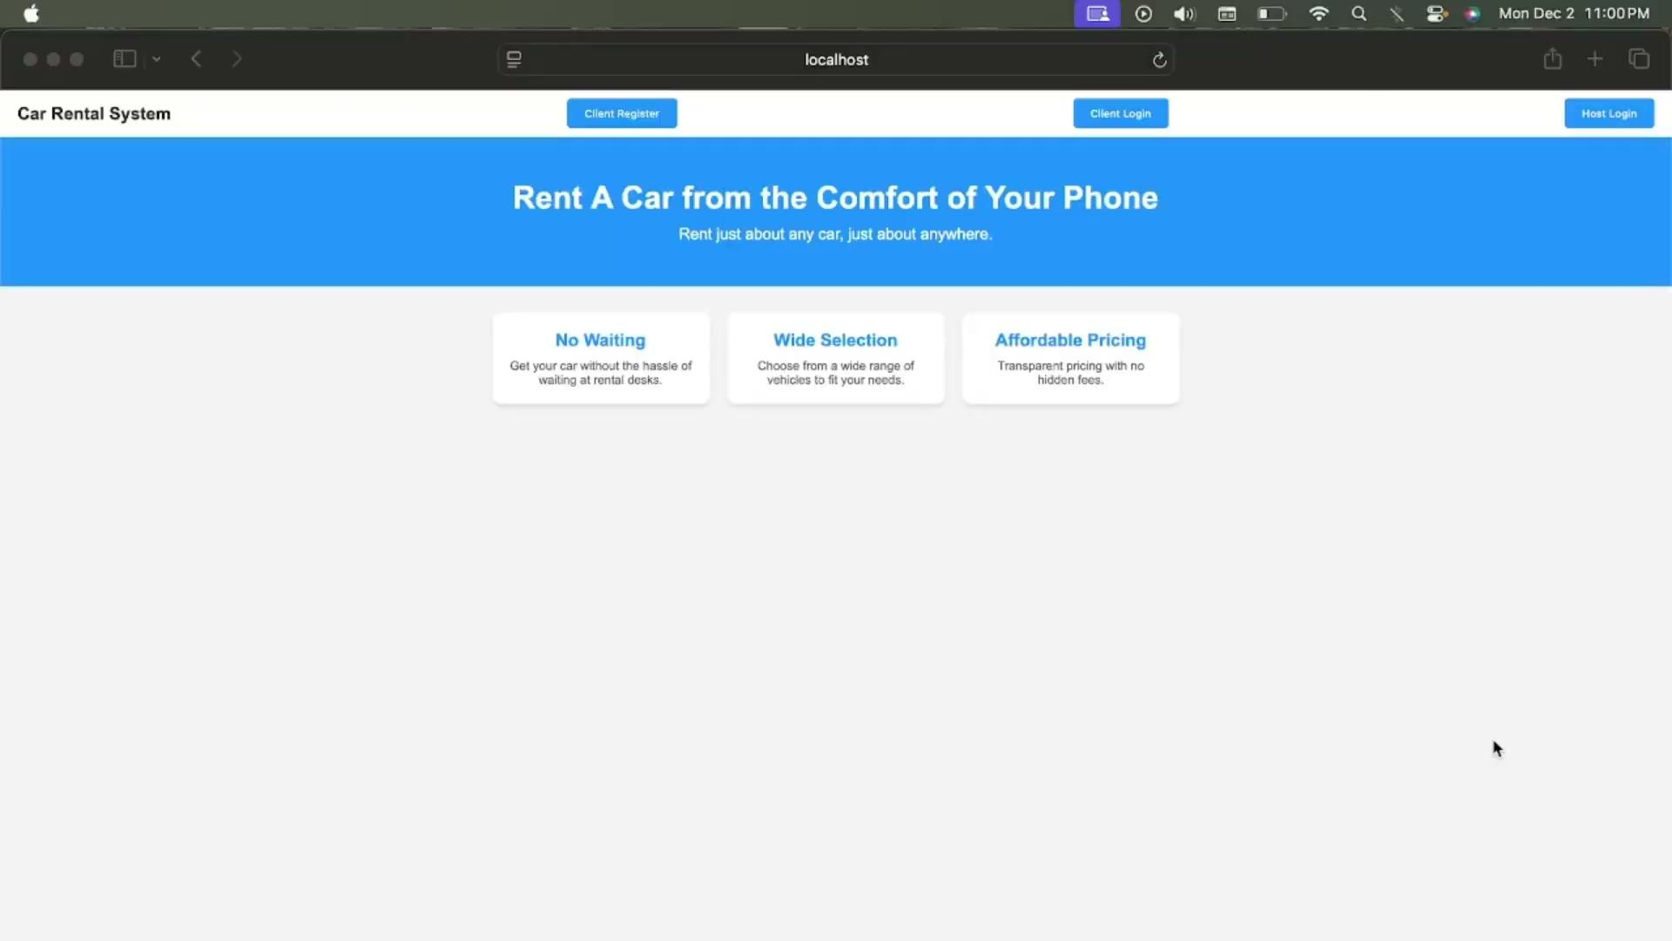
Demo
Video
12.04.2024

Slide 20

Thank You for your attention
Team 16:
Aguirre-Rosales Mario
Corna Filippo
Kowalik Marcin
Merchant Aamir
12.04.2024

